Slide 1

Mapping the Research on Digital Innovation in Health. A Bibliometric Approach
the presentation is financed by NAWA
Scott W. Hegerty, PhD, Department of Economics, Northeastern Illinois University, USA, email: s-hegerty@neiu.edu
Marzenna Anna Weresa, PhD, World Economy Research Institute,, SGH Warsaw School of Economics, Poland, email: mweres@sgh.waw.pl

Slide 2
Presentation outline
Research background
Objectives and research questions
Methods and data
Results
Discussion & conclusions

Slide 3
Research background
RESEARCH RATIONALE
Growing need to search for breakthrough innovative solutions in heath to make it more accessible and more efficient.
Digital transformation of organizations (including health providers) and the challenge to improve technology capability.
2 broad areas: (1) innovative medicines (e.g., vaccines innovative pharmaceuticals), (2) digital technologies in healthcare services: patients’ monitoring & treatment, prevention, self-care (e.g., telemedicine, use of health tracking digital devices or apps).
THE NEED TO UNDERSTAND:
The concept of digital innovation in terms of scientific research environments.
Topics related to digital innovation in health that have become important.
Theoretical base useful for explaining digital innovation in health

Slide 4
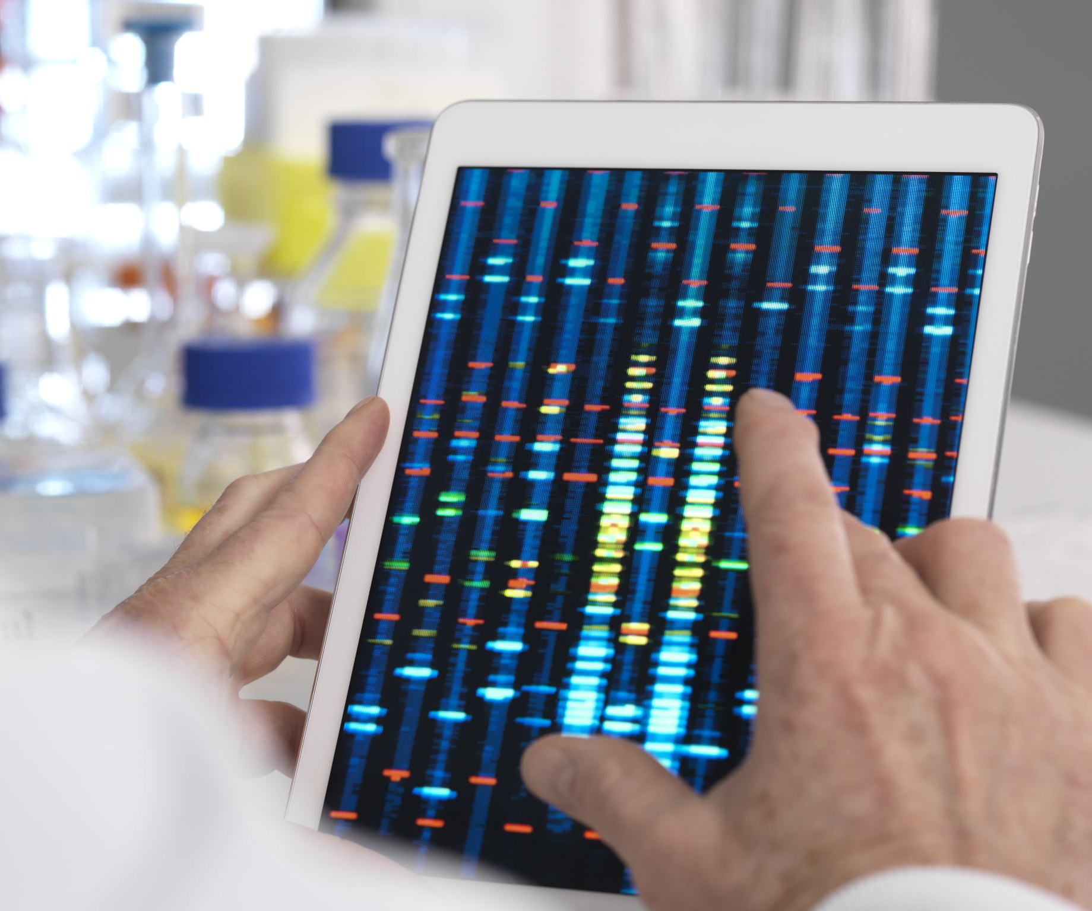


Research objective
To map the scientific literature on digital innovations in the health sector;
To identify the most important research topics and the most influential papers on digital innovation in health;
To compare the research in the field of digital health in the EU and the US using mathematical and statistical methods

Slide 5
Research questions
What are the current trends in research and publication ecosystem related to digital innovation in the health sector?
What aspects of digital innovation in health are undertaken in research in economic sciences, and what are the contexts of this research?
Which publications constitute the main theoretical foundations that explain the concept of digital innovation in health sector?

Slide 6
Methodology
Bibliometric methodology defined as the application of mathematical and statistical methods to analyse written communication (Pritchard, 1969) such as articles, books, scientific manuscripts as well as bibliographic citations and co-citations (Broadus, 1982; Pendlebury, 2010; Yalcin & Daim, 2021).
Science mapping used to explore the structure and evolution of a focal research area
VOSviewer software as a tool to perform the analysis, and to provide the visualization
R package bibliometrix also useful

Slide 7
Data
- DATA SOURCE: Scopus a high-quality digital database of peer-reviewed scientific publications (scientific journals, books, and conference proceedings),
- Covers over 25,100 titles from more than 5,000 international publishers from different fields (science, technology, medicine, social sciences, and arts and humanities);
- YEARS COVERED: 2005 - 2022

Slide 8
Search strategy
We searched: titles, abstracts and keywords of articles, conference papers, reviews and conference reviews
Search #1 ( TITLE-ABS-KEY ( "digital innovation*" AND "health*" ) OR TITLE-ABS-KEY ("E-health*" OR "Telemedicine*" ) ) AND ( LIMIT-TO ( SUBJAREA , "SOCI" ) ) = 3,749 document results (too broad categories)
Search #2 ( TITLE-ABS-KEY ( "digital innovation*" ) AND TITLE-ABS-KEY ( health* ) OR TITLE-ABS-KEY (e-health) OR TITLE-ABS-KEY (telemedicine) OR TITLE-ABS-KEY (medicine) OR TITLE-ABS-KEY (online) ) AND (LIMIT-TO ( DOCTYPE , "ar" ) OR LIMIT-TO ( DOCTYPE , "cp" ) OR LIMIT-TO ( DOCTYPE , "re" ) OR LIMIT-TO ( DOCTYPE , "cr" ) ) AND ( LIMIT-TO (LANGUAGE , "English" ) ) = 435 document results published in 329 journals

Slide 9
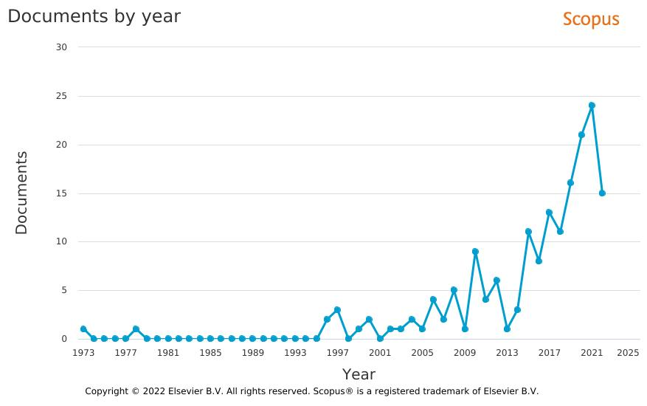

Slide 10
Summary of data source and selection
Data source | Scopus database
Citation indices
Searching period | January, 1, 2005- October, 26, 2022
Subject categories | "digital innovation" AND "health" OR "e-health" OR "telemedicine" OR "medicine" OR "online"
Document types | articles OR reviews OR Conference papers OR vonference reviews
Language | English
Sample size | 435

Slide 11
RESULTS
the presentation is financed by NAWA

Slide 12
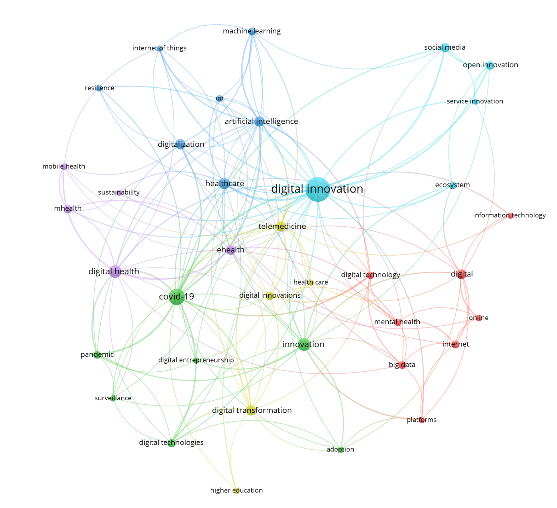
Co-occurrence of research topics*
Six main areas of topics (topic clusters)
*5 as the minimum number of occurrences of keywords.

Slide 13
Main areas of topics where digital innovation/technology in health is studied
Cluster 1 combining research on big data, digital and information technologies, Internet and mental health;
Cluster 2 consisting of topics related to adoption of digital technologies, digital entrepreneurship and innovation seen in the context of surveillance and COVID-19 pandemic;
Cluster 3 composed of papers that see digital innovation in health from the resilience perspective;
Cluster 4 containing papers that connect digital innovation in health care with higher education;
Cluster 5 focused e- health and sustainability;
Cluster 6 looking at digital innovation and other innovation types (social innovation, open innovation service innovation) in the context of the whole innovation ecosystem;

Slide 14
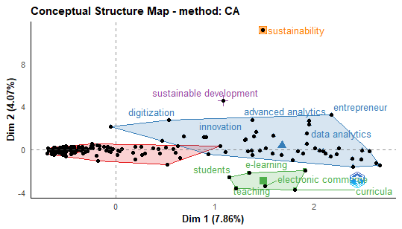
Conceptual clusters

Slide 15
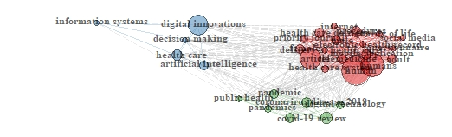
Keyword Co-occurrences

Slide 16
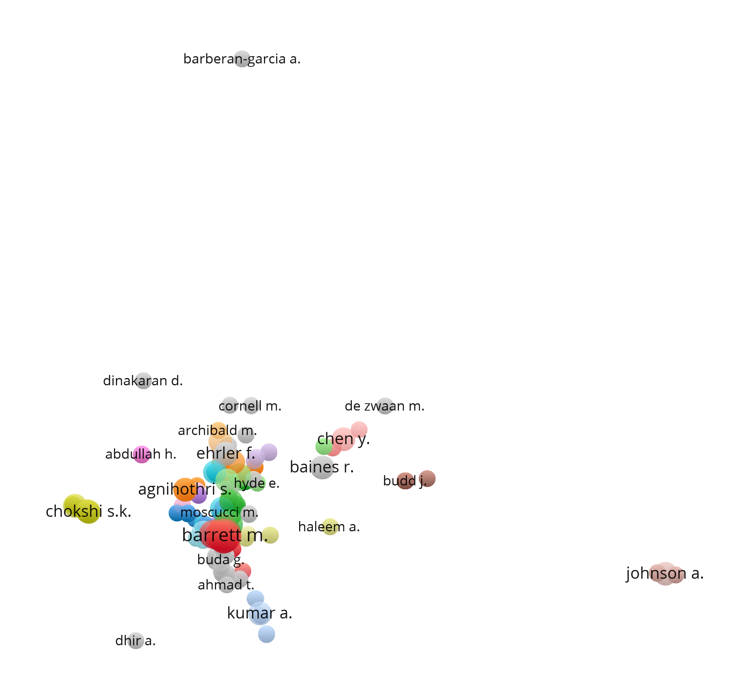
Authors - bibliographic coupling (minimum number of docs by author =1; min citation of an author = 1)
614 authors were selected (out of 1494 authors)
the total strength of bibliometric coupling links with other authors was calculated
The most influential authors:

Slide 17
Top 5 highly cited papers
Authors | Title | Year of publications | Journal | Cited by
Budd J., Miller B.S., Manning E.M., Lampos V., Zhuang M., Edelstein M., Rees G., Emery V.C., Stevens M.M., Keegan N., Short M.J., Pillay D., Manley E., Cox I.J., Heymann D., Johnson A.M., McKendry R.A. | Digital technologies in the public-health response to COVID-19 | 2020 | Nature Medicine | 340
Barrett M., Oborn E., Orlikowski W.J., Yates J. | Reconfiguring boundary relations: Robotic innovations in pharmacy work | 2012 | Organization Science | 210
Boudreau K.J., Jeppesen L.B. | Unpaid crowd complementors: The platform network effect mirage | 2015 | Strategic Management Journal | 181
Li J.-P.O., Liu H., Ting D.S.J., Jeon S., Chan R.V.P., Kim J.E., Sim D.A., Thomas P.B.M., Lin H., Chen Y., Sakomoto T., Loewenstein A., Lam D.S.C., Pasquale L.R., Wong T.Y., Lam L.A., Ting D.S.W. | Digital technology, tele-medicine and artificial intelligence in ophthalmology: A global perspective | 2021 | Progress in Retinal and Eye Research | 99
Lehne M., Sass J., Essenwanger A., Schepers J., Thun S. | Why digital medicine depends on interoperability | 2019 | npj Digital Medicine | 99

Slide 18
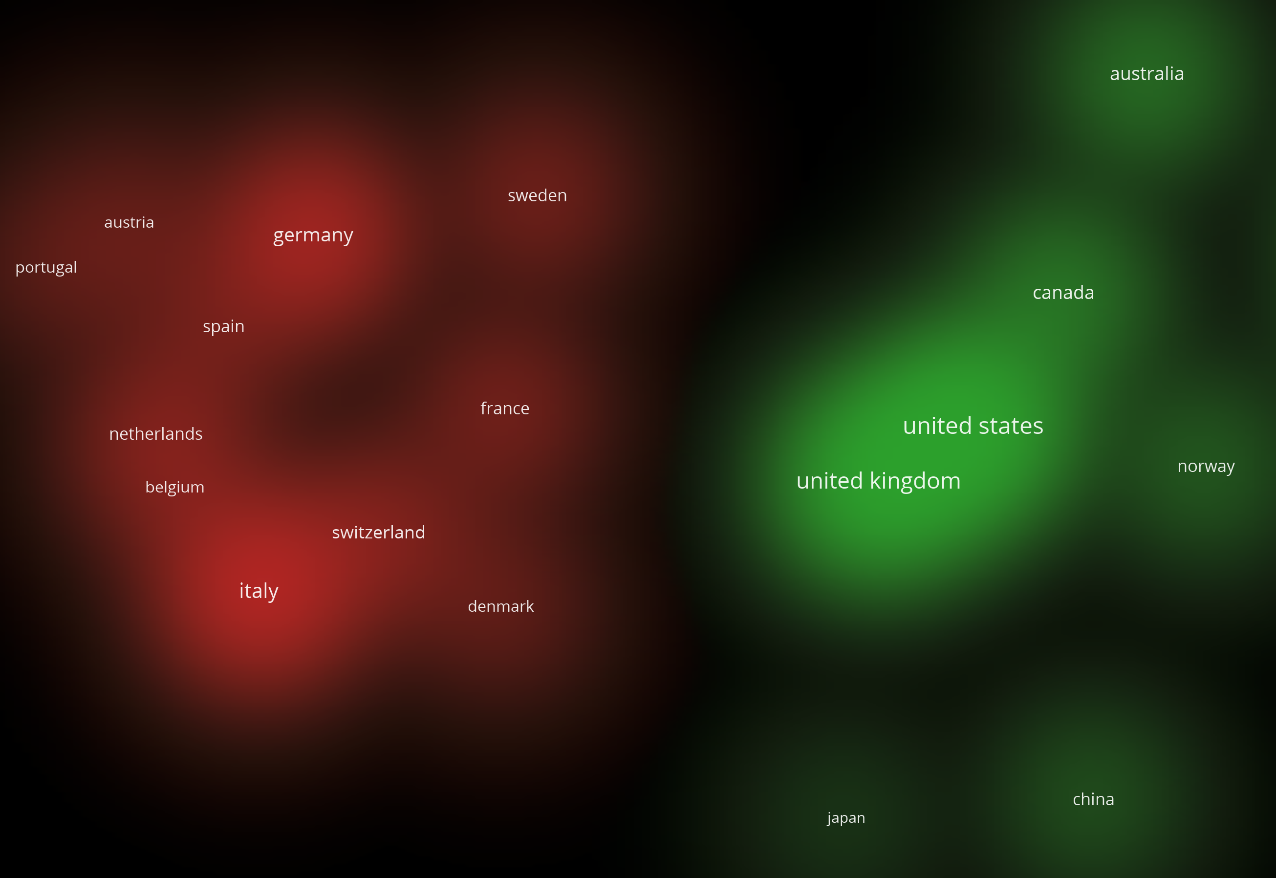
Density of research collaboration
Research collaboration –
2 groups:
Anglo-Saxon
European
Research procedure:
Min. no docs by country= 5;
Out of 92 countries, 25 met threshold
For each of 25 countries the total strength of co-authorship with other countries is calculated
Countries with total link strength >10 selected (20 countries selected)

Slide 19
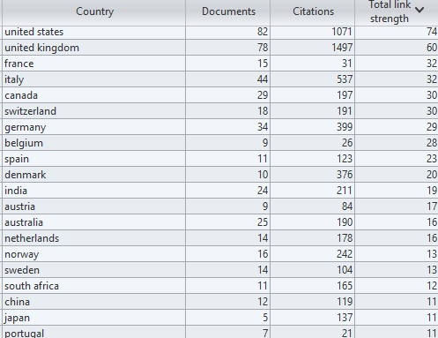
Co-authorship by country: detailed data

Slide 20
Citations within 435 papers
Preliminary R coding: Separate included reference list
Wrangle the data: Last names first Eliminate URLs, other data
Problem: Different citation styles (dates first, etc).
→ 19,592 papers
Remaining issues: “Close” matches
→ Matched with papers
→ Also matched visually?

Slide 21
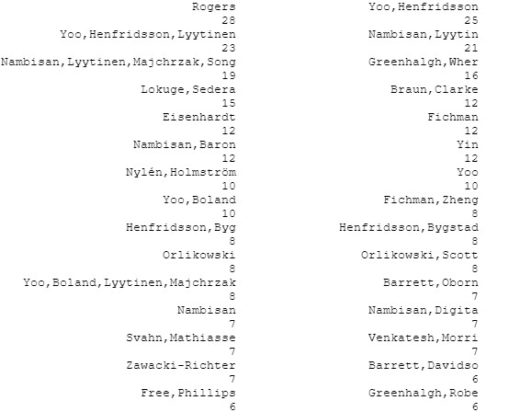
R output: Top-Cited papers

Slide 22
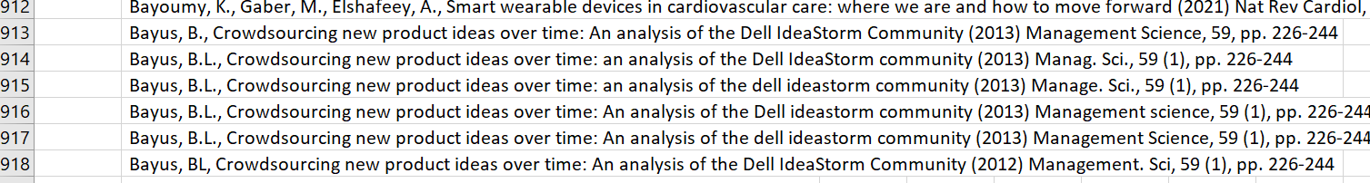
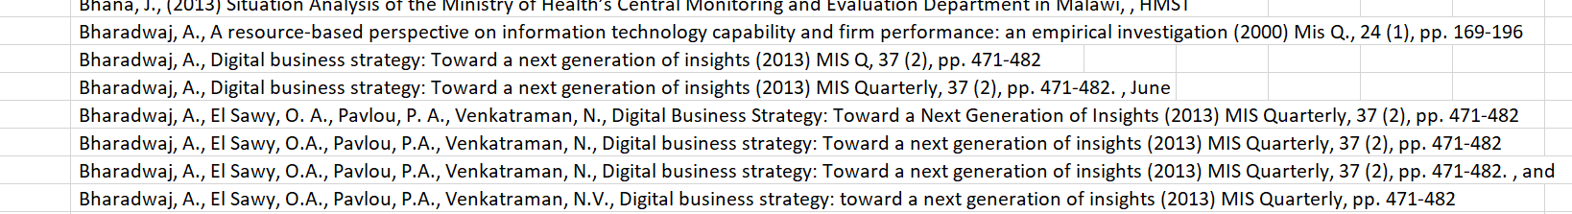
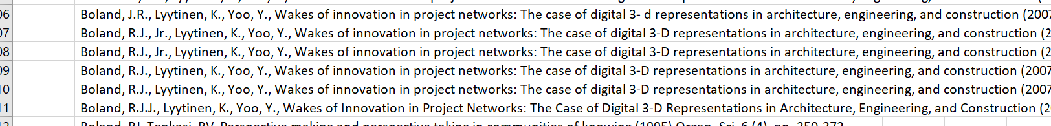
Example of Issue:

Slide 23
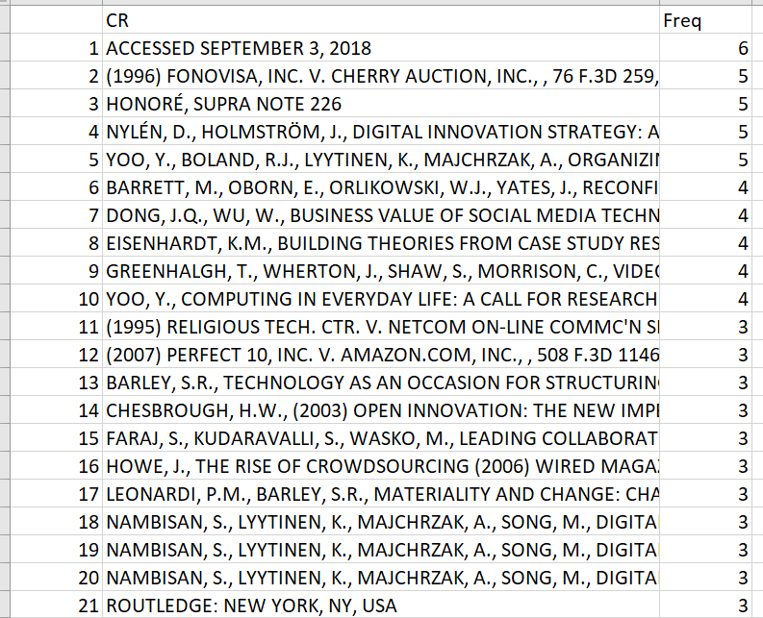
R package: Not much better?
bibliometrix

Slide 24
Most-cited papers (1/2)
Barrett, M., Davidson, E., Prabhu, J., Vargo, S.L., Service innovation in the digital age: key contributions and future directions (2015) Mis Q., 39 (1), pp. 135-154. , [Article]
Braun, V., Clarke, V., Using thematic analysis in psychology (2006) Qual Res Psychol, 3, pp. 77-101
Eisenhardt, K.M., Building theories from case study research (1989) Acad. Manag. Rev., 14 (4), pp. 532-550
Fichman, R.G., Dos Santos, B.L., Zheng, Z., Digital innovation as a fundamental and powerful concept in the information systems curriculum (2014) MIS Q., 38 (2), pp. 329-343
Free, C., Phillips, G., Galli, L., Watson, L., Felix, L., Edwards, P., Patel, V., Haines, A., The effectiveness of mobile-health technology-based health behaviour change or disease management interventions for health care consumers: A systematic review (2013) PLoS Med, 10 (1). , https://doi.org/10.1371/journal.pmed.1001362
Greenhalgh, T., Robert, G., Bate, P., Macfarlane, F., Kyriakidou, O., Diffusion of Innovations in Health Service Organisations: a Systematic Literature Review (2008), John Wiley & Sons
Henfridsson, O., Bygstad, B., The Generative Mechanisms of Digital Infrastructure Evolution (2013) Management Information Systems Quarterly, 37 (3), pp. 896-931
Nambisan, S., Digital entrepreneurship: toward a digital technology perspective of entrepreneurship (2017) Enterpren. Theor. Pract., 41 (6), pp. 1029-1055
Nambisan, S., Lyytinen, K., Majchrzak, A., Song, M., Digital innovation management: reinventing innovation management research in a digital world (2017) Mis Quarterly, 41 (1), pp. 223-238

Slide 25
Most-cited papers (2/2)
Nylén, D., Holmström, J., Digital innovation strategy: a framework for diagnosing and improving digital product and service innovation (2015) Business Horizons, 58 (1), pp. 57-67
Orlikowski, W.J., Scott, S.V., Sociomateriality: Challenging the separation of technology, work and organization (2008) Acad. Management Ann., 2 (1), pp. 433-474
Rogers, E.M., (2003) Diffusion of Innovations, , Free Press, New York, NY, USA
Svahn, F., Mathiassen, L., Lindgren, R., Embracing Digital Innovation in Incumbent Firms: How Volvo Cars Managed Competing Concerns (2017) Management Information Systems Quarterly, 41 (1), pp. 239-253
Venkatesh, V., Morris, M.G., Davis, G.B., Davis, F.D., User acceptance of information technology: toward a unified view (2003) MIS Q, 27, pp. 425-478
Yin, R.K., (2009) Case study research: design and methods, 4th edn, , Sage, Los Angeles
Yoo, Y., Boland, R.J., Lyytinen, K., Majchrzak, A., Organizing for innovation in the digitized world (2012) Organization Science, 23 (5), pp. 1398-1408
Yoo, Y., Computing in everyday life: A call for research on experiential computing (2010) MIS Quarterly: Management Information Systems, 34, pp. 213-231. , (SPEC. 2)
Yoo, Y., Henfridsson, O., Lyytinen, K., Research commentary-the new organizing logic of digital innovation: an agenda for information systems research (2010) Information Systems Research, 21 (4), pp. 724-735
Zawacki-Richter, O., (2004) Support im Online Studium—Die Entstehung eines neuen pädagogischen Aktivitätsfeldes [Student support in online distance education], , Innsbruck, Austria, StudienVerlag

Slide 26
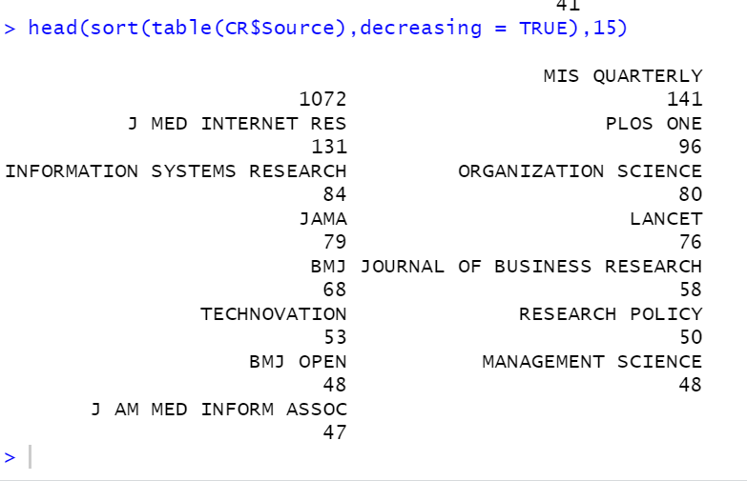
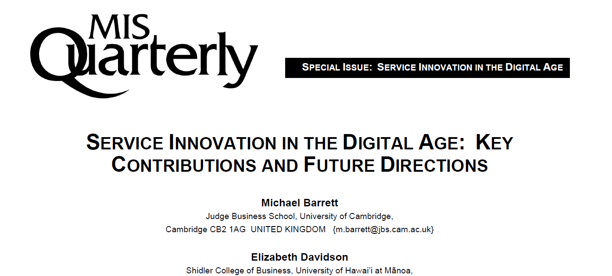
Major Cited Source:
MIS Quarterly
Confirmed using R package bibliometrix

Slide 27
Co-citations
ARTICLE | x
NAMBISAN S. LYYTINEN K. MAJCHRZAK A. SONG M. DIGITAL INNOVATION MANAGEMENT: REINVENTING INNOVATION MANAGEMENT RESEARCH IN A DIGITAL WORLD (2017) | 19
YOO Y. HENFRIDSSON O. LYYTINEN K. THE NEW ORGANIZING LOGIC OF DIGITAL INNOVATION: AN AGENDA FOR INFORMATION SYSTEMS RESEARCH (2010) | 17
YOO Y. BOLAND R.J. LYYTINEN K. MAJCHRZAK A. ORGANIZING FOR INNOVATION IN THE DIGITIZED WORLD (2012) | 12
EISENHARDT K.M. BUILDING THEORIES FROM CASE STUDY RESEARCH (1989) | 10
ROGERS E.M. (2003) | 10
HENFRIDSSON O. BYGSTAD B. THE GENERATIVE MECHANISMS OF DIGITAL INFRASTRUCTURE EVOLUTION (2013) | 9
FICHMAN R.G. DOS SANTOS B.L. ZHENG Z. DIGITAL INNOVATION AS A FUNDAMENTAL AND POWERFUL CONCEPT IN THE INFORMATION SYSTEMS CURRICULUM (2014) | 8
NAMBISAN S. DIGITAL ENTREPRENEURSHIP: TOWARD A DIGITAL TECHNOLOGY PERSPECTIVE OF ENTREPRENEURSHIP (2017) | 8
BRAUN V. CLARKE V. USING THEMATIC ANALYSIS IN PSYCHOLOGY (2006) | 7
NYLÉN D. HOLMSTRÖM J. DIGITAL INNOVATION STRATEGY: A FRAMEWORK FOR DIAGNOSING AND IMPROVING DIGITAL PRODUCT AND SERVICE INNOVATION (2015) | 7
SVAHN F. MATHIASSEN L. LINDGREN R. EMBRACING DIGITAL INNOVATION IN INCUMBENT FIRMS: HOW VOLVO CARS MANAGED COMPETING CONCERNS (2017) | 7
YOO Y. COMPUTING IN EVERYDAY LIFE: A CALL FOR RESEARCH ON EXPERIENTIAL COMPUTING (2010) | 7
DONG J.Q. WU W. BUSINESS VALUE OF SOCIAL MEDIA TECHNOLOGIES: EVIDENCE FROM ONLINE USER INNOVATION COMMUNITIES (2015) | 6
KOHLI R. MELVILLE N.P. DIGITAL INNOVATION: A REVIEW AND SYNTHESIS (2019) | 6
LANGLEY A. STRATEGIES FOR THEORIZING FROM PROCESS DATA (1999) | 6
LUSCH R.F. NAMBISAN S. SERVICE INNOVATION: A SERVICE-DOMINANT LOGIC PERSPECTIVE (2015) | 6
YOO Y. HENFRIDSSON O. LYYTINEN K. RESEARCH COMMENTARY-THE NEW ORGANIZING LOGIC OF DIGITAL INNOVATION: AN AGENDA FOR INFORMATION SYSTEMS RESEARCH (2010) | 6
ADNER R. KAPOOR R. VALUE CREATION IN INNOVATION ECOSYSTEMS: HOW THE STRUCTURE OF TECHNOLOGICAL INTERDEPENDENCE AFFECTS FIRM PERFORMANCE IN NEW TECHNOLOGY GENERATIONS (2010) | 5

Slide 28
Limitations
May need to refine search terms
Check for inconsistencies in spelling, etc.
No mechanism, just taxononomy: Expand mathematical methods?
Can use more advanced methods for “distance” between terms, for example

Slide 29
Discussion and Conclusions
435 papers found on “digital innovation” in Scopus
Six conceptual clusters discovered: mental health; the COVID-19 pandemic; resilience; higher education; e- health and sustainability; and the innovation ecosystem;
Two geographic clusters: Anglo-US and Europe
Identified most-cited (among the 455 and within the 435); co-citations
Further research into these warranted: MIS Quarterly, source papers, etc.

Slide 30
Thank you for your atention
the presentation is financed by NAWA

